Slide 1
Chapter 2
Comparative Advantage
© 2019 McGraw-Hill Education. All rights reserved. Authorized only for instructor use in the classroom. No reproduction or distribution without the prior written consent of McGraw-Hill Education.

Slide 2
Learning Objectives
Explain and apply the Principle of Comparative Advantage.
Explain and apply the Principle of Increasing Opportunity Cost (also called the Low-Hanging-Fruit Principle).
Identify factors that shift the menu of production possibilities.
Explain and apply the role of comparative advantage in international trade and describe why some jobs are more vulnerable to outsourcing than others.

Slide 3
Exchange and Opportunity Cost 1
Joe Jamail, a highly successful trial attorney, employs another attorney to write his will
Writing your own will: 2 hours
Opportunity cost of 2 hours: $10,000+
Hiring someone to spend 4 hours on your will: $800
Do It Yourself only when
Opportunity cost < hired cost

Slide 4
Exchange and Opportunity Cost 2
A person has an absolute advantage at a particular task if he or she can perform the task in fewer hours than the other person
A person has a comparative advantage at a particular task if his or her opportunity cost of performing the task is lower than the other person’s opportunity cost
Comparative advantage doesn’t just care about your skill at a task, but about your skill at that task compared to your skill at other tasks

Slide 5
The Principle of Comparative Advantage 1
The Principle of Comparative Advantage Everyone does best when each person (or each country) concentrates on the activities for which his or her opportunity cost is the lowest.

Slide 6
The Principle of Comparative Advantage 2
Multiple people are faced with multiple tasks. How should they assign the work?
Each should concentrate on the activities for which they have the lowest opportunity cost
Total value of output increases with specialization and trade

Slide 7
Comparative Advantage Example 1
Production Times | Web Update | Bike Repair
Mary | 20 minutes | 10 minutes
Paula | 30 minutes | 30 minutes
Paula and Mary can each update web pages and repair bikes
Mary has an absolute advantage in both
Comparative advantage drives specialization
So who has a comparative advantage in what?

Slide 8
Comparative Advantage Example 2
Production Times | Web Update | Bike Repair
Mary | 20 minutes | 10 minutes
Paula | 30 minutes | 30 minutes
Opportunity Cost | Web Update | Bike Repair
Mary | 2 repairs | 0.5 update
Paula | 1 repair | 1 update

Slide 9
Comparative Advantage Example 3
Production Times | Web Update | Bike Repair
Mary | 20 minutes | 10 minutes
Paula | 30 minutes | 30 minutes
Hourly Output | Web Update | Bike Repair
Mary | 3 updates | 6 repairs
Paula | 2 updates | 2 repairs

Slide 10
Comparative Advantage Example 4
Hourly Output | Web Update | Bike Repair
Mary | 3 updates | 6 repairs
Paula | 2 updates | 2 repairs
16 web updates are ordered
Mary spends half her time at each activity: 12 updates and 24 repairs
Paula produces 4 updates and 12 repairs
Total output 16 updates and 36 repairs
Specialization produces 16 updates and 48 repairs
12 more repairs for the same inputs!

Slide 11
Another Example
Hourly Output | Web Update | Bike Repair
Pat | 2 updates | 1 repair
Meg | 3 updates | 3 repairs
This table shows output per hour
Apply the Principle of Comparative Advantage
Look at opportunity cost per unit
Pat repairs bikes and Meg updates web pages
Opportunity Cost | Web Update | Bike Repair
Pat | ½ repair | 2 updates
Meg | 1 repair | 1 update

Slide 12
Where Have All the 0.400 Hitters Gone
None since 1941
Not a decline in athletic ability
Specialization keeps averages lower
Pitching and fielding skills have improved
Pitchers specialize in starters, middle relievers, and closers; right- or left-handed batters; strikeouts
Fielders play one position
Specialized coaches
Detailed analysis of hitters' weaknesses

Slide 13
Sources of Comparative Advantage
Talent
Natural resources
Cultures or societal norms
Languages
Institutions
Value placed on craftsmanship
Support for entrepreneurship

Slide 14
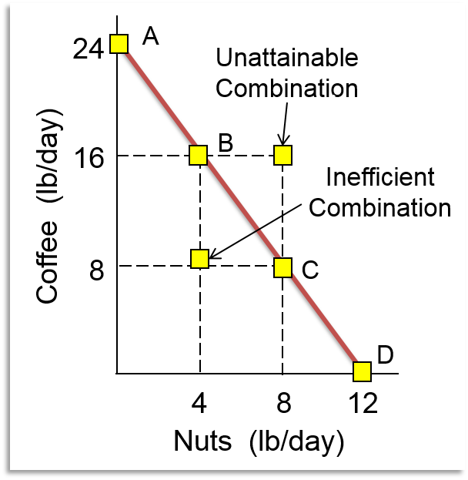
Production Possibilities Curve
A production possibilities curve illustrates the combinations of two goods that can be produced with given resources
Definitions:
Unattainable point
Attainable point
Inefficient point
Efficient point
Scarcity Principle
Give up one good to get another

Slide 15
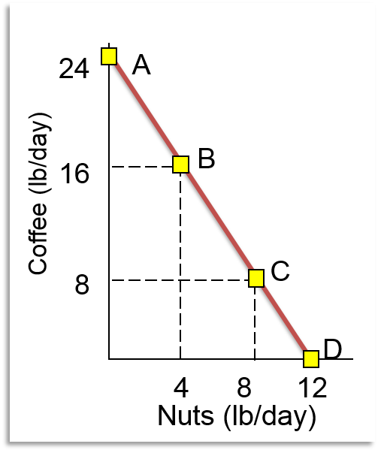
Susan’s Production Possibilities
Two goods: coffee and nuts
Work 6 hours per day
1 hour of labor
= 4 pounds of coffee OR
= 2 pounds of nuts
Graph shows options
Negative slope

Slide 16
Susan’s Opportunity Costs
Marginal cost: – 8 coffee
Marginal benefit: 4 nuts
Loss in coffee
Gain in nuts
Opportunity cost of 1 nut is 2 coffee
Marginal cost: – 8 nut
Marginal benefit: 16 coffee
Loss in nuts
Gain in coffee
Opportunity cost of 1 coffee is ½ nut

Slide 17
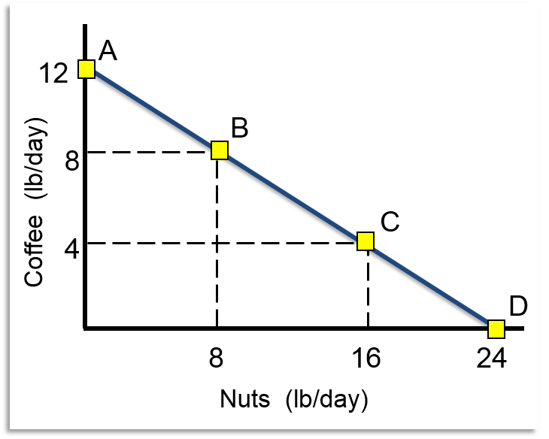
Tom’s Production Possibilities
Work 6 hours per day
Productivity determines the slope of the PPC
1 hour of labor
= 4 pounds of nuts OR
= 2 pounds of coffee
Opportunity cost
Marginal cost: – 4 coffee
Marginal benefit: 8 nuts
Tom's opportunity cost of 1 coffee is 2 nuts
His opportunity cost of 1 nut is ½ coffee

Slide 18
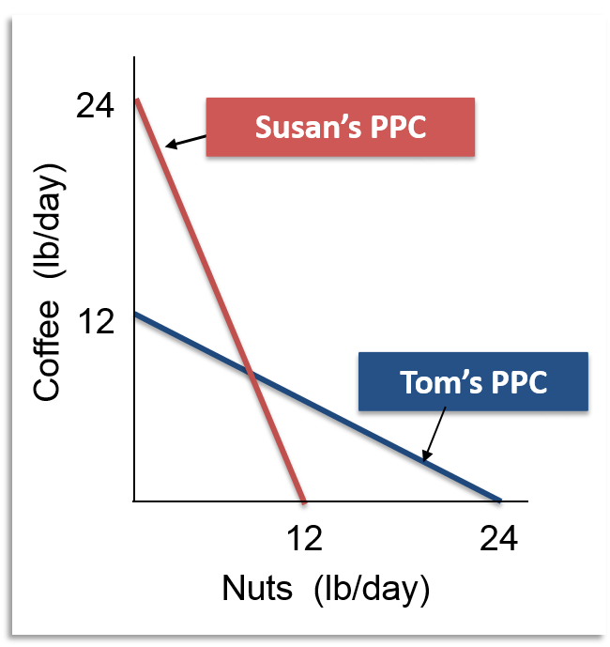
Tom, Meet Susan
PPCs show comparative advantage
Sue's curve is steeper, better for coffee
Tom's curve is flatter, better for nuts
Comparative advantage is a comparison
To get 1 coffee
Sue gives up ½ nuts
Tom gives up 2 nuts

Slide 19
Gains from Specialization and Trade 1
Without trade, each person can consume along his production possibilities curve
What you produce determines what you consume
With trade, each person's consumption can be greater than production
Produce according to comparative advantage
Trade to get what you want

Slide 20
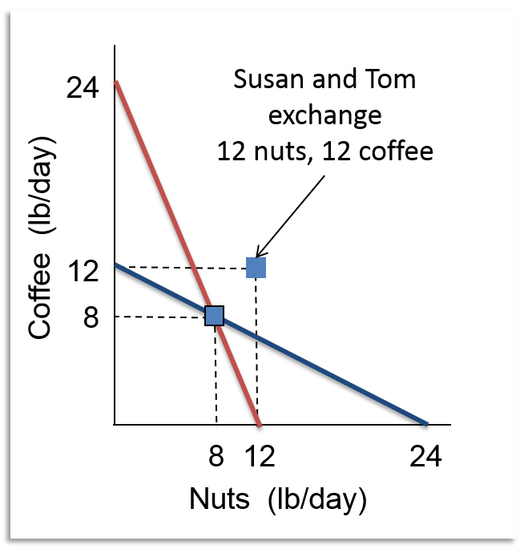
Gains from Specialization and Trade 2
Preferred diet is half nuts, half coffee
No trade: 8 pounds of coffee and 8 pounds of nuts
Total output is 32 pounds
Specialization gives each person 12 pounds of each good
48 total pounds

Slide 21
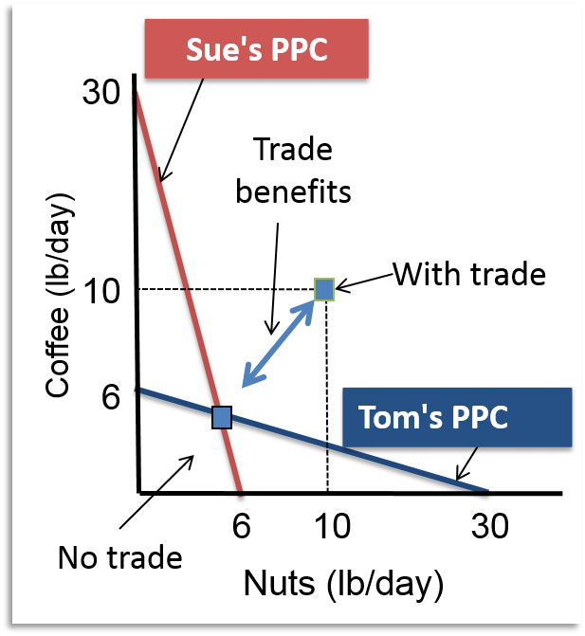
Gains from Specialization and Trade 3
Benefits increase when differences in opportunity cost increase
Sue's opportunity cost of one pound of nuts increases to 5 coffee
Tom's opportunity cost of one pound of coffee increases to 5 nuts
No trade: 5 nuts and 5 coffee each
With trade: 10 nuts and 10 coffee each

Slide 22
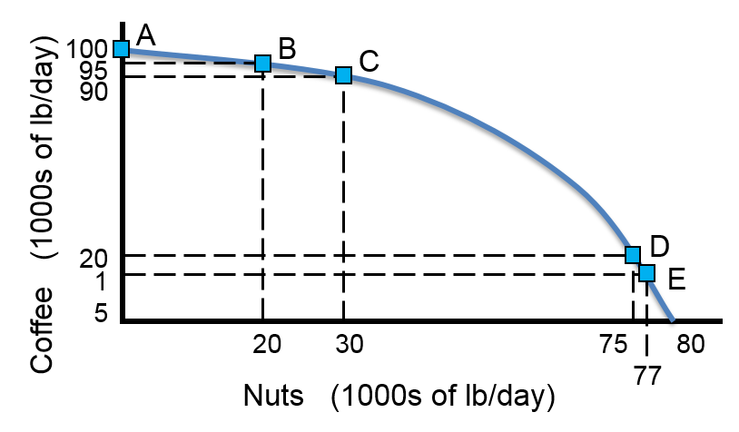
Production Possibilities for an Economy
Two goods: coffee and nuts
Multiple people
Different opportunity costs
Intercepts show maximum production of one good
Some resources better at coffee, some better at nuts

Slide 23
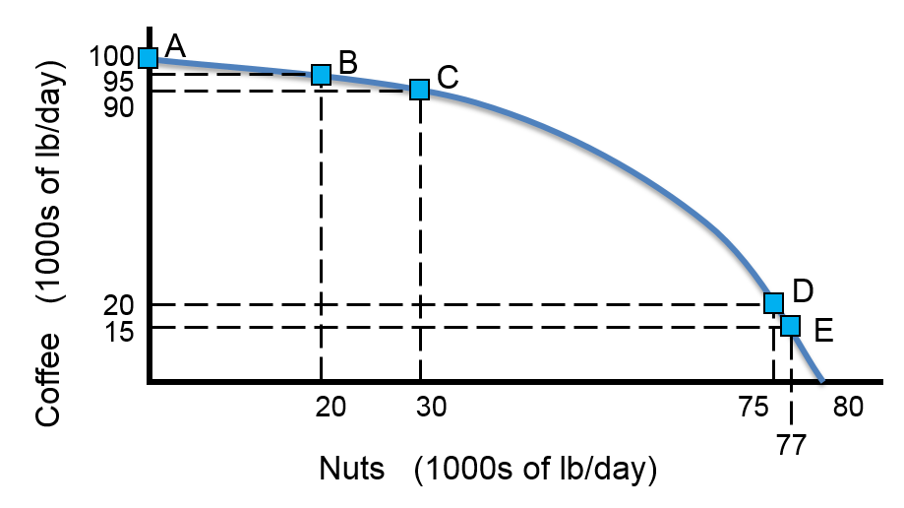
The Principle of Increasing Opportunity Cost 1
Maximum coffee: 100,000 lb. / day
Give up 5,000 pounds coffee, get 20,000 pounds of nuts
Give up another 5,000 pounds of coffee, get 10,000 additional pounds of nuts

Slide 24
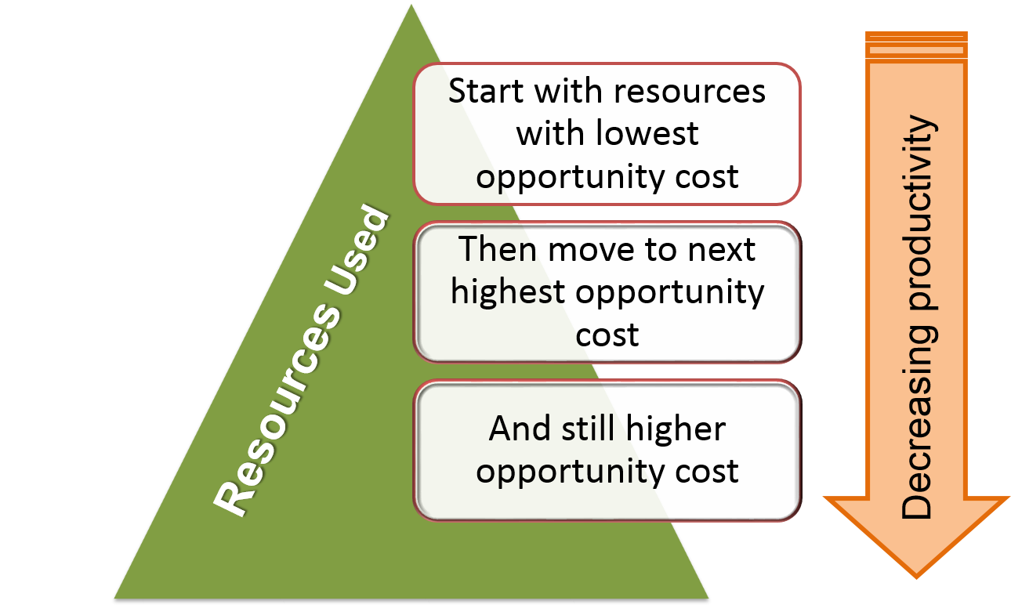
The Principle of Increasing Opportunity Cost 2

Slide 25
The Dynamic Economy
A PPC represents current choices
Changes in choices occur over time due to
More resources
Investment in capital
Population growth
Improvements in technology
More specialization: start-up and switching costs
Increases in knowledge

Slide 26
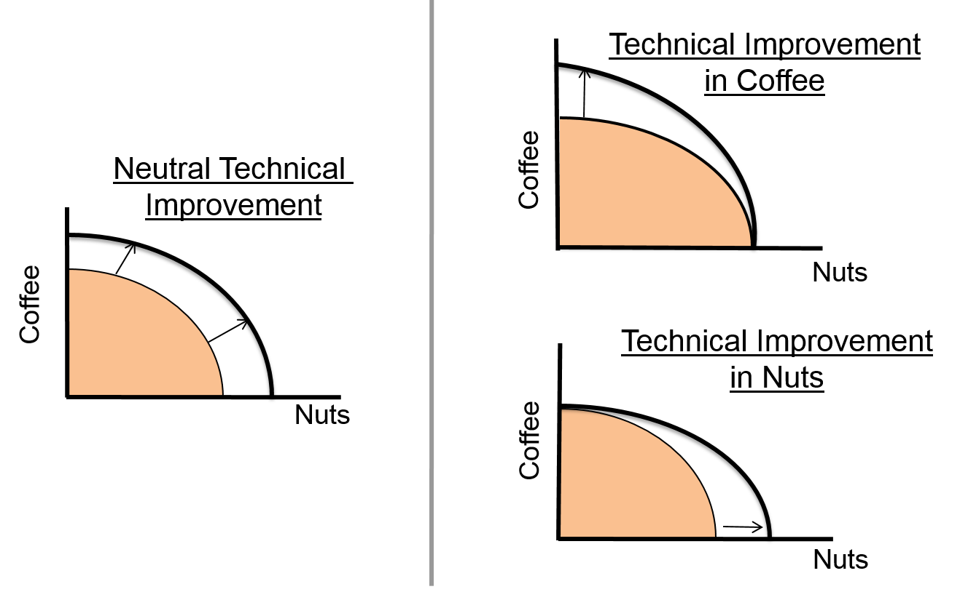
Shifts in PPC

Slide 27
Some Countries Resist Specialization
Specialization is easier when
Population density passes a threshold
Markets are connected
Transportation for goods
Communications for services
Legal framework supports business
Financial markets enable start-ups

Slide 28
Too Much Specialization
Imagine this:
Your hair stylist only cuts blonde hair
An expert in tropical diseases opens a practice in a town of 500 people in Wisconsin
Seven bookstores, each open a different day of the week

Slide 29
Comparative Advantage and International Trade
Principle of Comparative Advantage and gains from trade apply worldwide
Potentially large gains from trading with different and distant countries
Trade can be controversial
Trade benefits society broadly
Costs are concentrated
Some industries suffer
People lose their jobs

Slide 30
Outsourcing
Service work performed overseas by low wage workers has been termed outsourcing
Medical transcription
Customer call centers
Medical tourism
Technical writing
Limits to outsourcing
Quality control
Physical presence (haircuts)
Complex communications
Understand nuance
Greatest security for workers is the ability to adapt quickly to changing circumstances

Slide 31
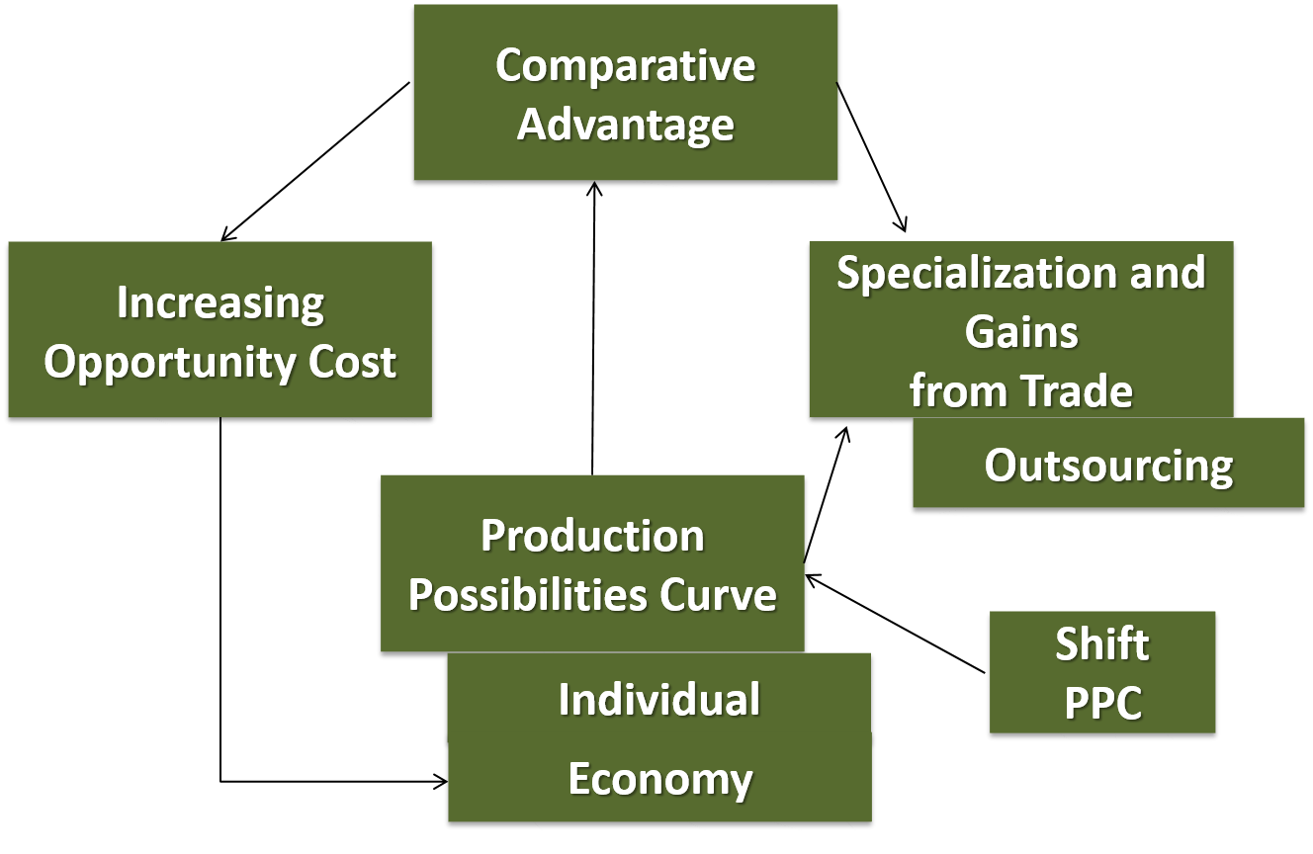
Comparative Advantage

